Slide 1
Sequencing protocol overview
Laboratory Module

Slide 2
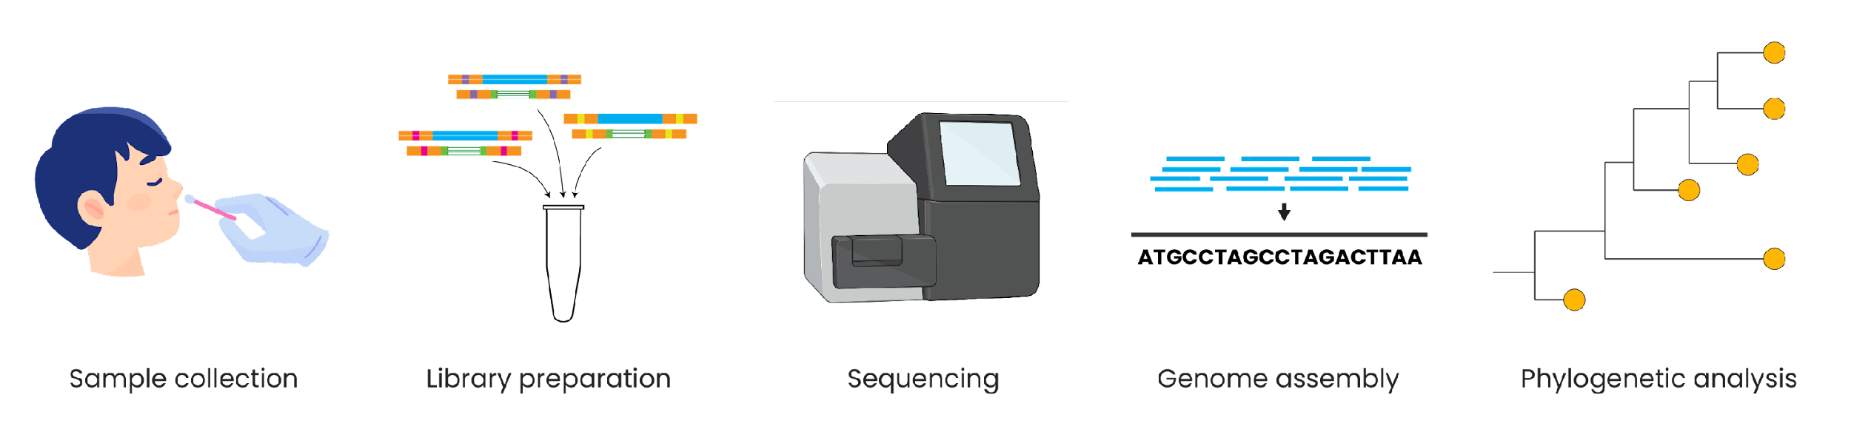
Genomic epidemiology workflow
BioRender.com
Pixel True https://www.pixeltrue.com/about, CC BY-SA 4.0, via Wikimedia Commons

Slide 3
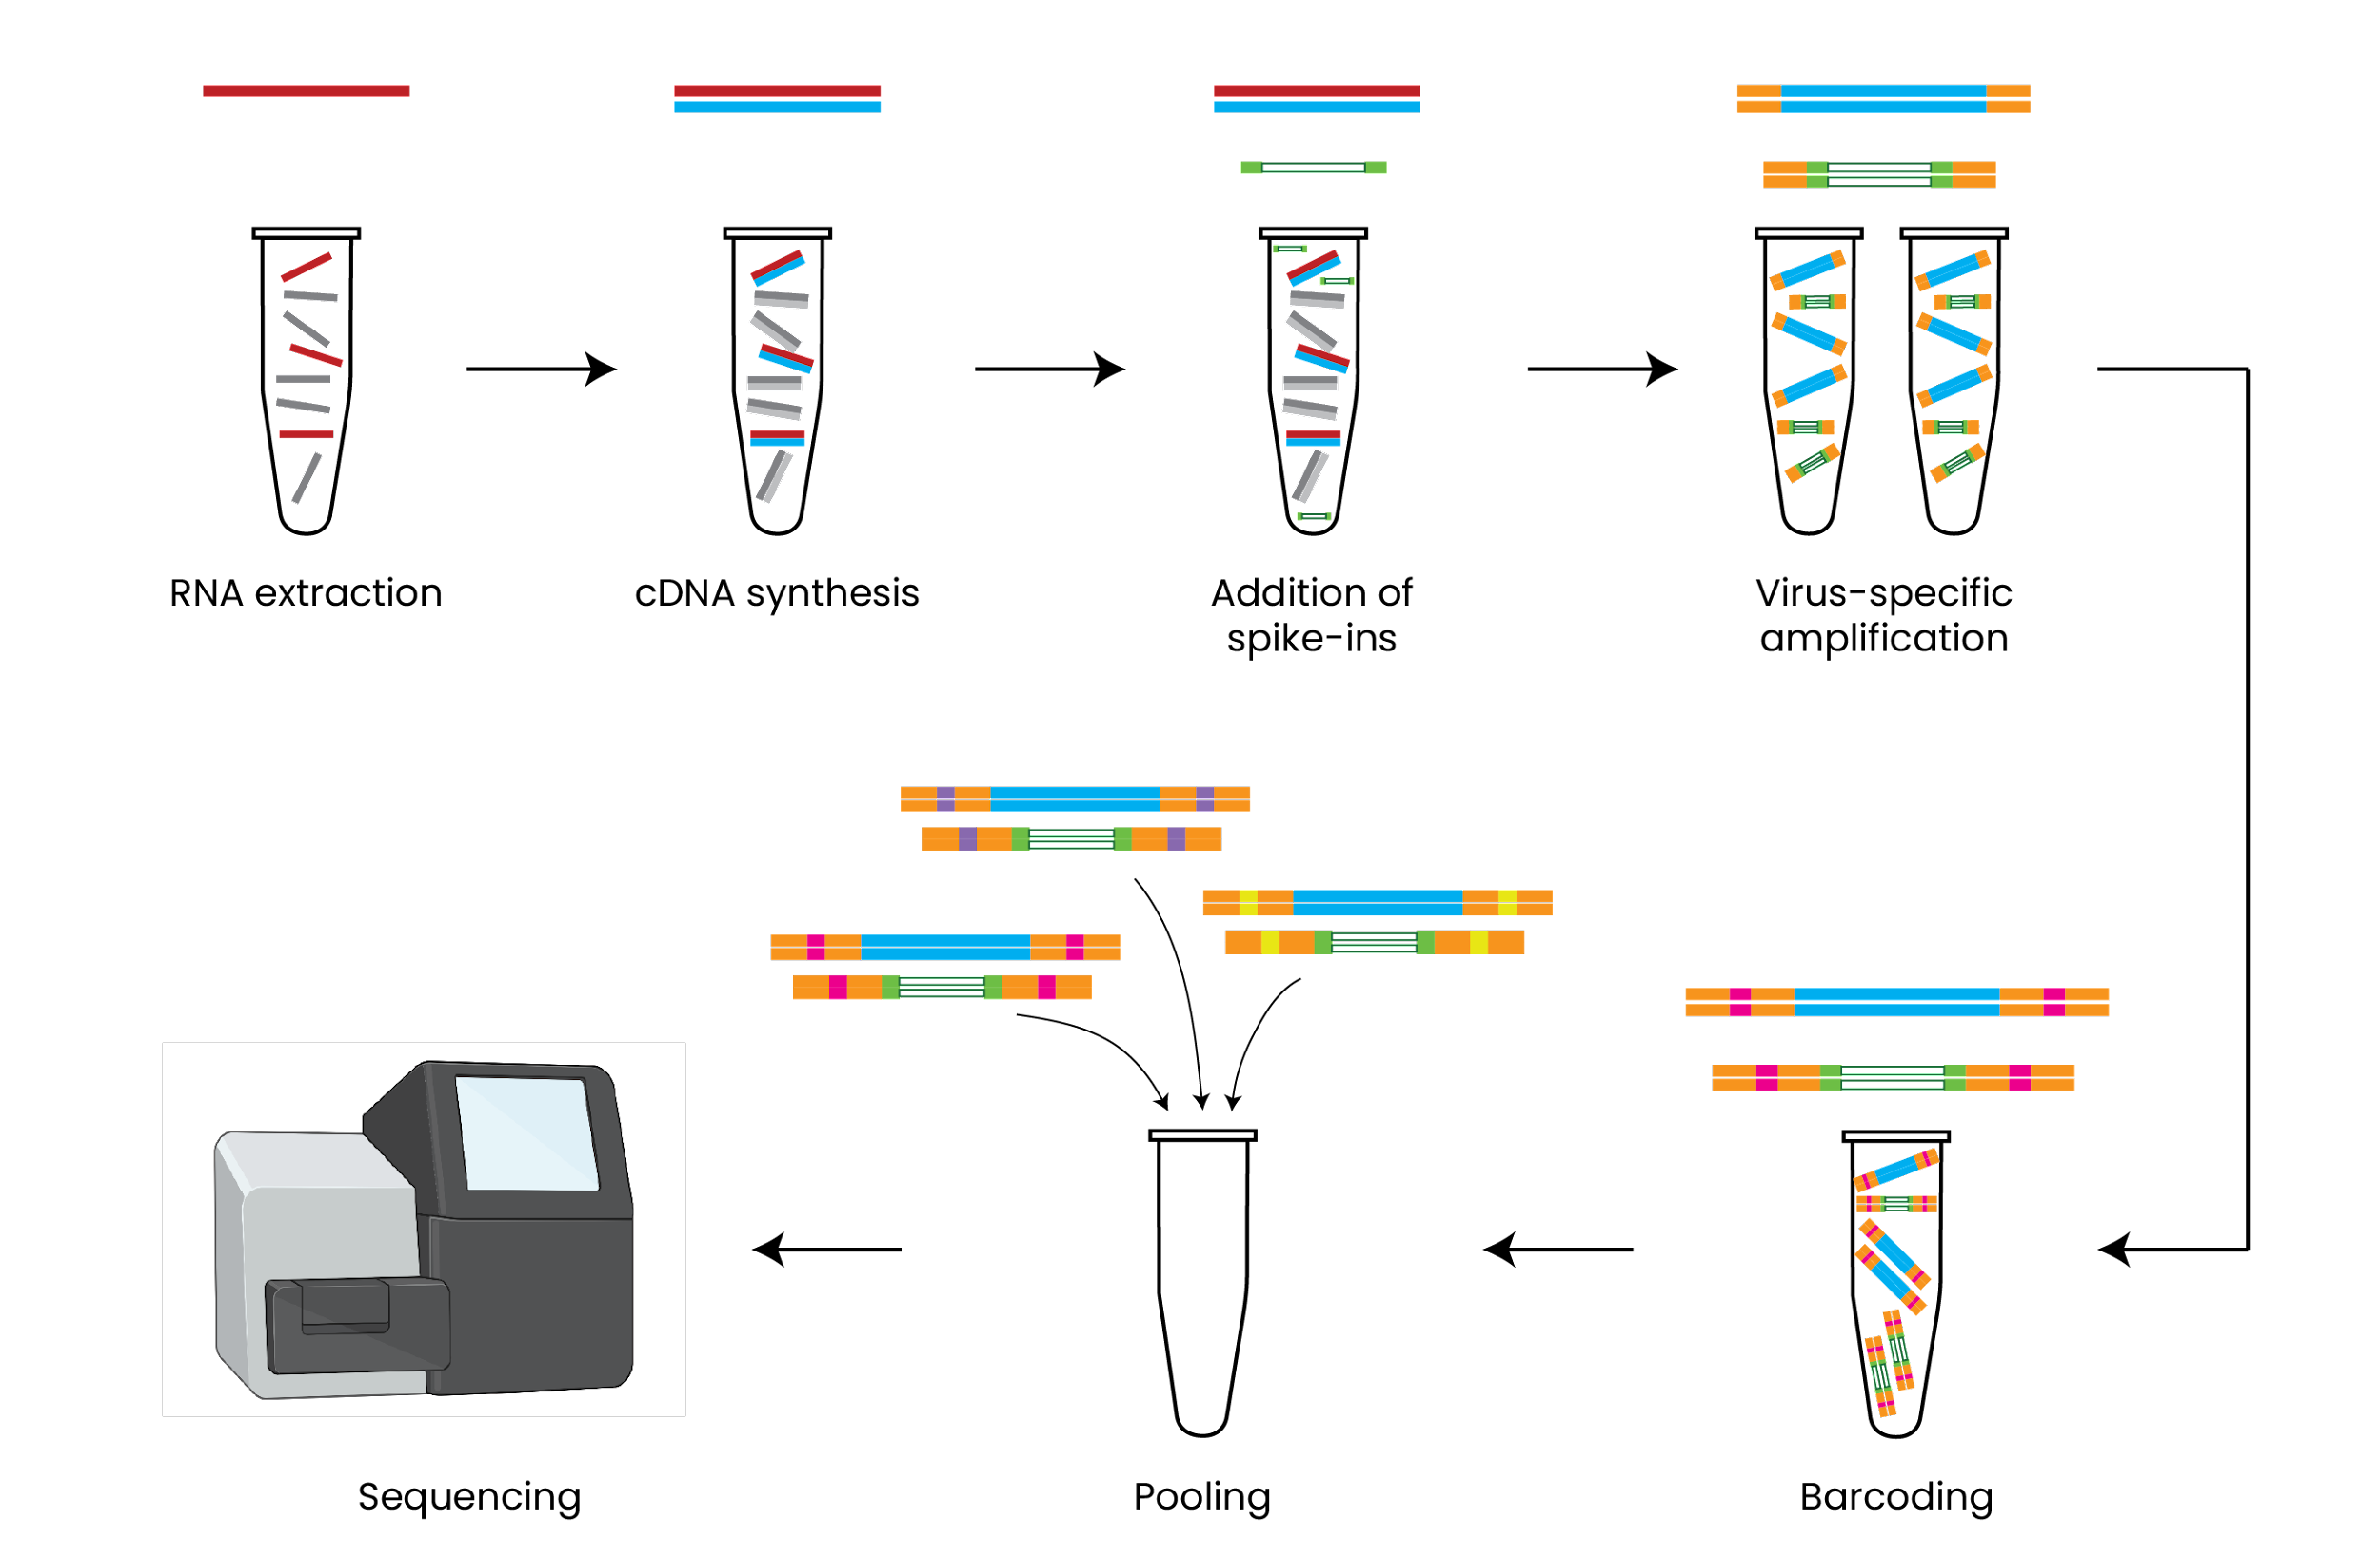
Conceptual overview of protocol

Slide 4
Outline
Minimizing inter-sample contamination
Working with temperature-sensitive materials
Using thermocyclers
Reagent handling
Sample pooling

Slide 5
Conceptual overview of protocol

Slide 6
Protocol Step
Extraction
cDNA prep
Amplicon PCR
Amplicon PCR clean up
Library indexing PCR
Library PCR clean up
Library quant and pooling
Sequencing

Slide 7
Protocol Step
Extraction
DNA- and RNA-free reagent preparation work space
cDNA prep
Amplicon PCR
Prepare in ‘clean’ work space (e.g. hood or bench) and transfer to other work spaces for sample loading
Amplicon PCR clean up
Library indexing PCR
Library PCR clean up
Library quant and pooling
Sequencing

Slide 8
Sample handling work space
Protocol Step
Extraction
Appropriate biosafety level laboratory
DNA- and RNA-free reagent preparation work space
cDNA prep
Pre-PCR
Amplicon PCR
Prepare in ‘clean’ work space (e.g. hood or bench) and transfer to other work spaces for sample loading
Amplicon PCR clean up
Library indexing PCR
Library PCR clean up
Library quant and pooling
Sequencing

Slide 9
Sample handling work space
Protocol Step
Extraction
Appropriate biosafety level laboratory
DNA- and RNA-free reagent preparation work space
cDNA prep
RNA extract and cDNA work space (e.g. hood in separate room)
Pre-PCR
Amplicon PCR
Prepare in ‘clean’ work space (e.g. hood or bench) and transfer to other work spaces for sample loading
Amplicon PCR clean up
Library indexing PCR
Library PCR clean up
Library quant and pooling
Sequencing

Slide 10
Sample handling work space
Protocol Step
Extraction
Appropriate biosafety level laboratory
DNA- and RNA-free reagent preparation work space
cDNA prep
RNA extract and cDNA work space (e.g. hood in separate room)
Pre-PCR
Amplicon PCR
Prepare in ‘clean’ work space (e.g. hood or bench) and transfer to other work spaces for sample loading
Amplicon PCR clean up
Amplicon work space (e.g. hood)
Library indexing PCR
Post-PCR
Library PCR clean up
Library quant and pooling
Sequencing

Slide 11
Sample handling work space
Protocol Step
Extraction
Appropriate biosafety level laboratory
DNA- and RNA-free reagent preparation work space
cDNA prep
RNA extract and cDNA work space (e.g. hood in separate room)
Pre-PCR
Amplicon PCR
Prepare in ‘clean’ work space (e.g. hood or bench) and transfer to other work spaces for sample loading
Amplicon PCR clean up
Amplicon work space (e.g. hood)
Library indexing PCR
Post-PCR
Library PCR clean up
Library work space (e.g. hood)
Library quant and pooling
Sequencing

Slide 12
Summary: Essential laboratory workspaces
Work space | Description
Clean area | Nucleic acid-free area for preparation of mastermixes, reaction tubes, reaction plates, etc. prior to sample loading.
Pre-PCR area | Area for handling viral RNA extracts and cDNA prior to multiplex amplicon PCR step.
Post-PCR area* | Area for handling amplicon and library PCR products. Can optionally be split into separate work spaces for amplicon and library products.
*Amplicon products are high concentration and pose a high contamination risk

Slide 13
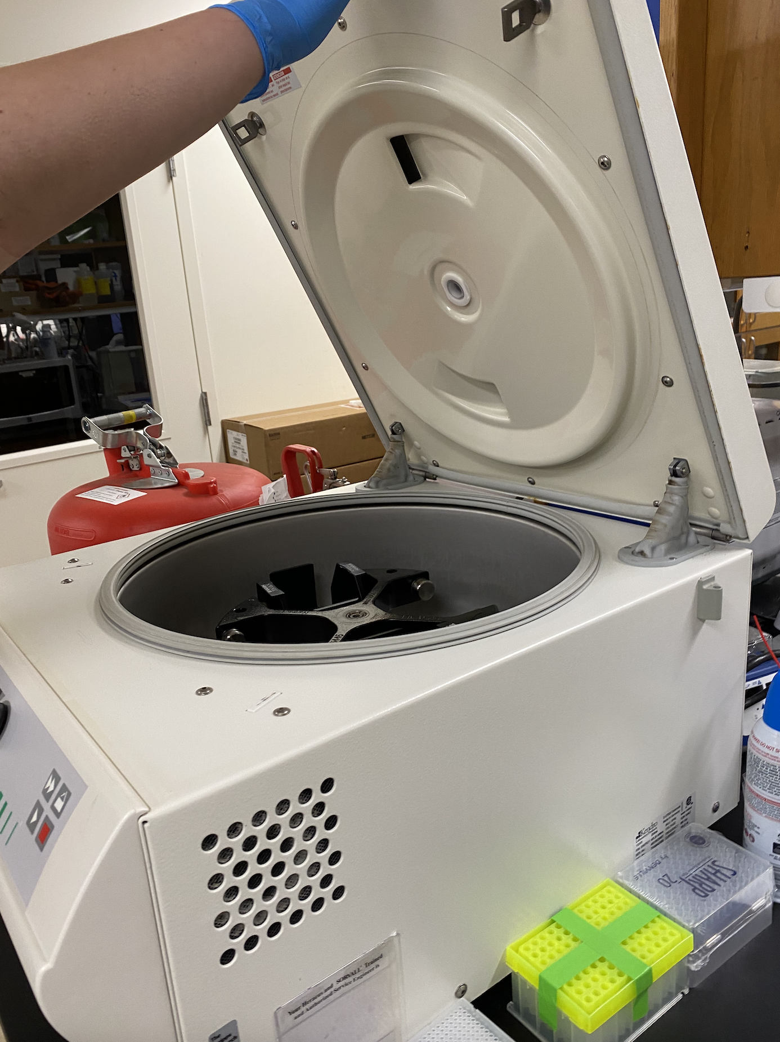
Minimizing inter-sample contamination
Seal samples tightly to prevent contamination, especially prior to long-term storage and thermocycler reactions
Always centrifuge plates and strips prior to opening
Make sure tips are tightly attached to active pipettes before loading sample
Aliquot longer-lasting reagents such as primer pools, SPRI beads, and enzyme master mixes
Use NTCs and spike-ins to check for contamination in final library

Slide 14
Outline
Minimizing inter-sample contamination
Working with temperature-sensitive materials
Using thermocyclers
Reagent handling
Sample pooling

Slide 15
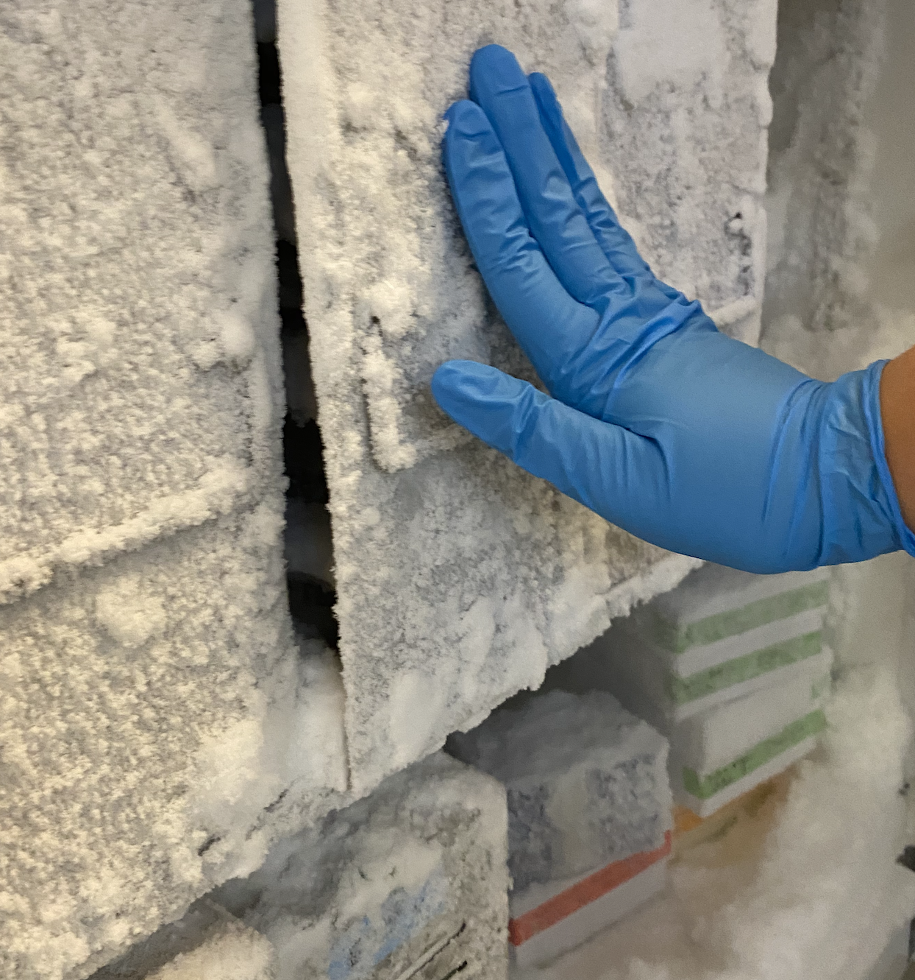
Working with temperature-sensitive materials
RNA is very volatile compared to DNA, so ensure that all RNA is kept cold at all times
Other temperature-sensitive reagents include: reverse transcriptase and DNA polymerase enzymes
Reduce the number of freeze-thaw cycles whenever possible

Slide 16
Summary: reagent storage temperatures
Storage temperature | Materials
-80˚C | Viral RNA extracts
-20˚C | PCR enzymes, primers, dsDNA (long term storage)
4˚C | SPRI beads, dsDNA (short-term storage)
~0˚C (ice buckets, ice blocks) | Temperature-sensitive reagents and samples in active use (e.g. during PCR preparation)
Room temperature | Ethanol, water

Slide 17
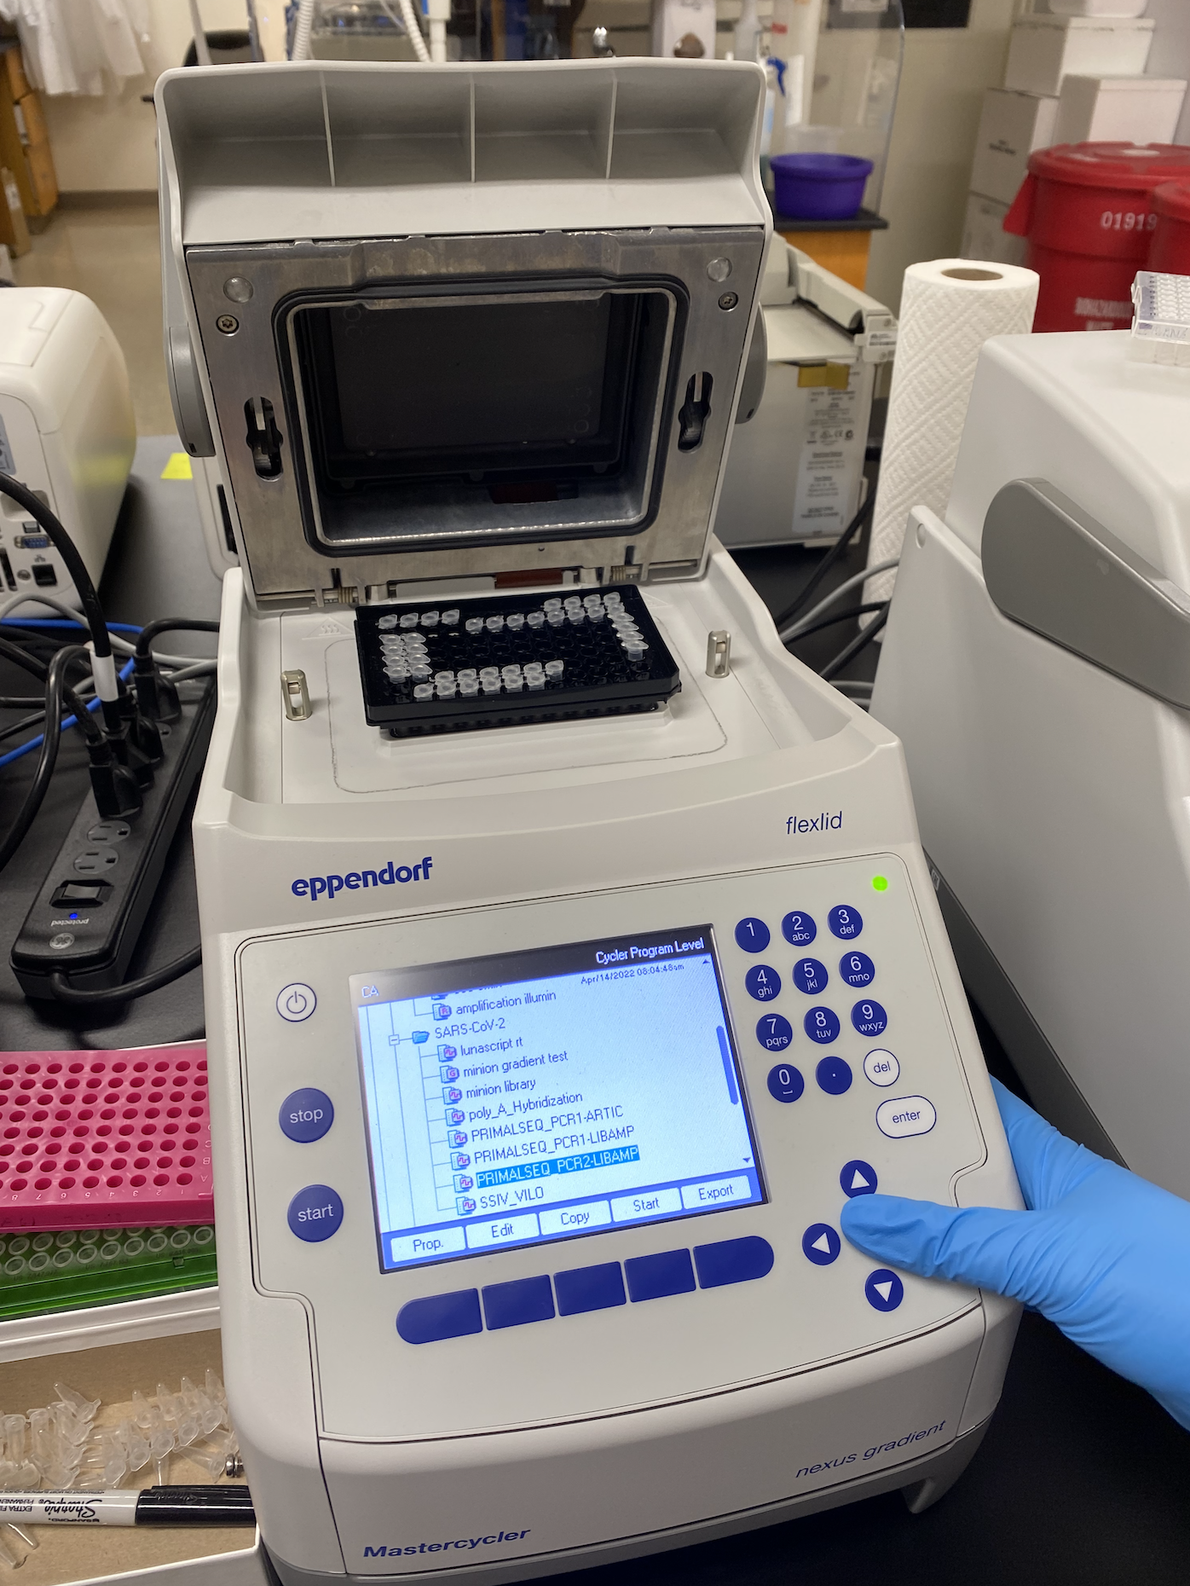
Optimizing thermocycler performance
Pre-heat thermocyclers during reaction preparation (e.g. sample loading step) if needed
Include at least 3 total 8-strips of tubes to equilibrate thermocycler lid pressure (empty “BALANCE” tubes OK) if using 8-strip tubes in thermocyclers
Avoid leaving samples on thermocyclers for long periods following the completion of PCR programs

Slide 18
Outline
Minimizing inter-sample contamination
Working with temperature-sensitive materials
Using thermocyclers
Reagent handling
Sample pooling

Slide 19
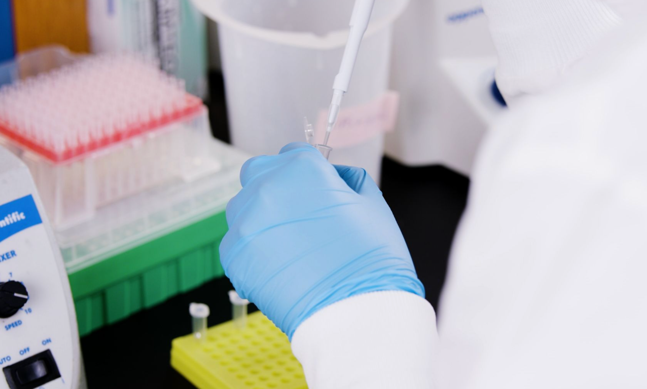
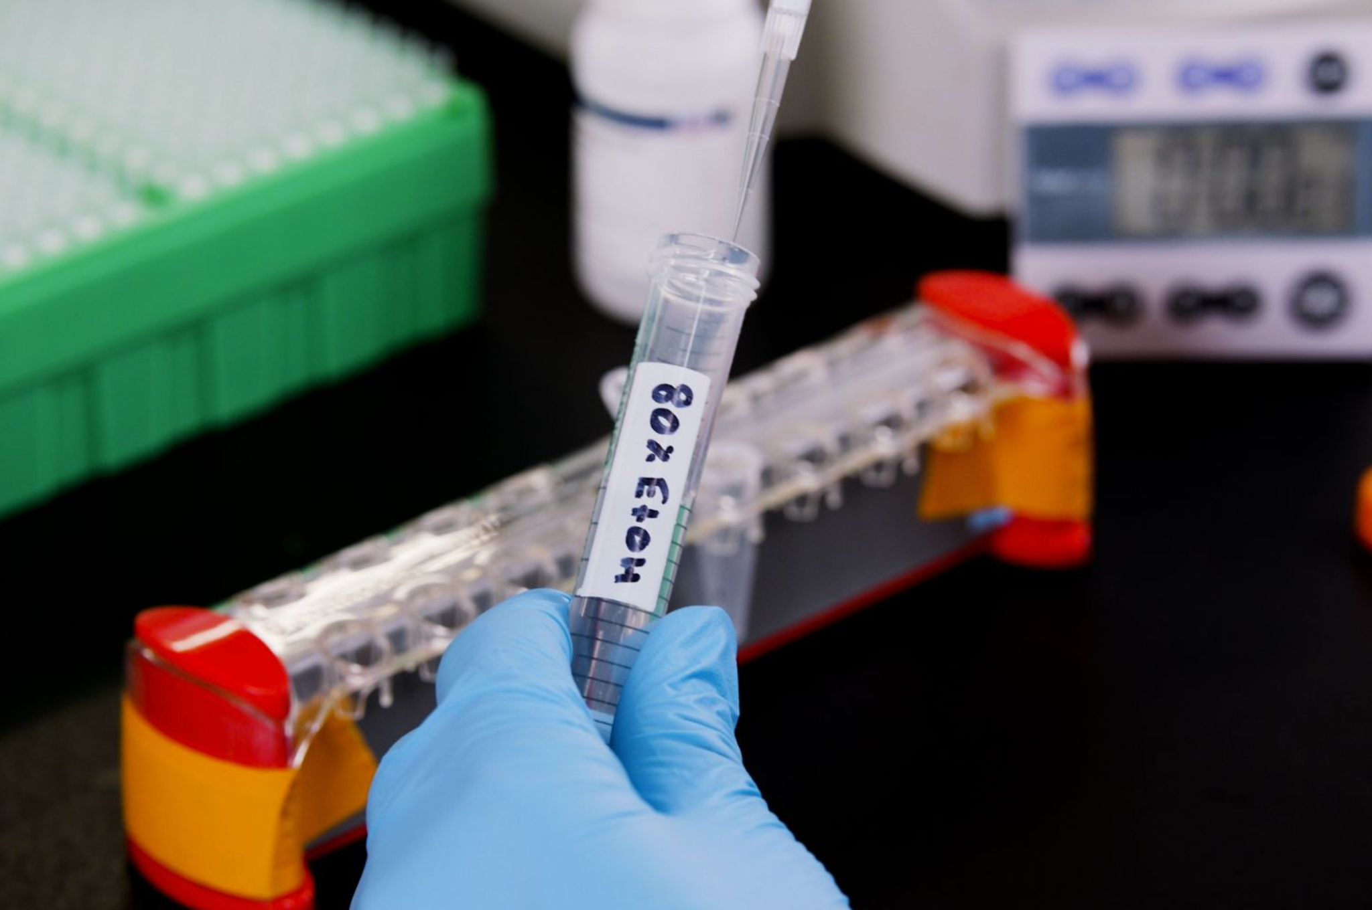
Proper reagent handling can improve results
Prepare mastermixes for a greater number of samples than theoretically needed to account for volume loss via pipetting and calibration issues
Prepare 80% EtOH solution for SPRIs on the same day the SPRIs are performed to prevent evaporation-driven decreases in EtOH content

Slide 20
Outline
Minimizing inter-sample contamination
Working with temperature-sensitive materials
Using thermocyclers
Reagent handling
Sample pooling

Slide 21
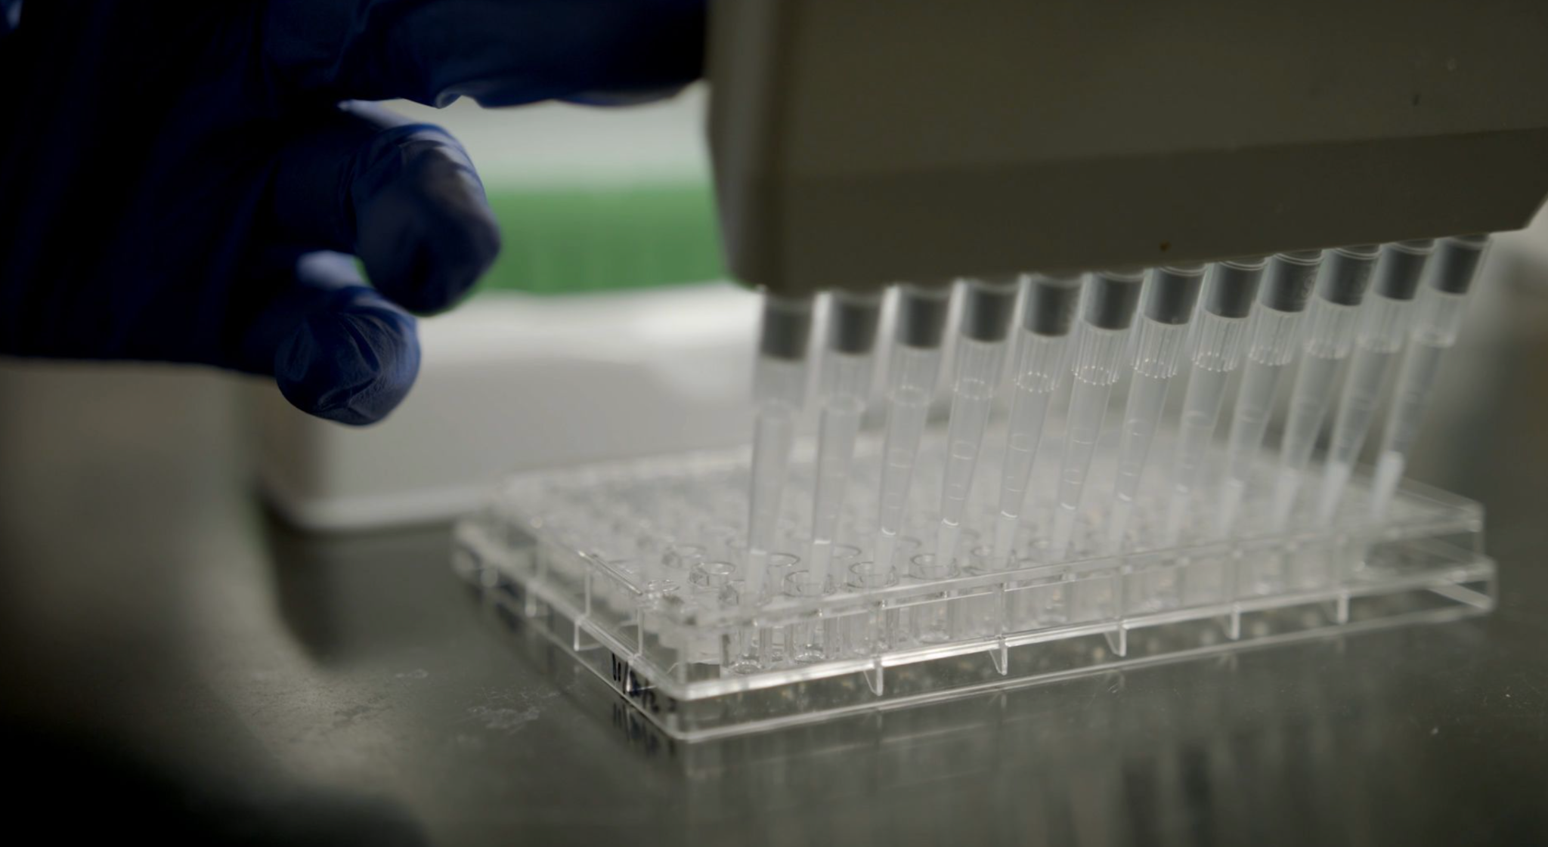
Pooling samples for even sequencing coverage
Maximum volume | 30 µL
Number of samples to pool | 3
Maximum volume per sample | ______ µL
Average sample concentration | 0.5 ng/µL
Target DNA amount | ______ ng

Slide 22
Pooling samples for even sequencing coverage
Maximum volume | 30 µL
Number of samples to pool | 3
Maximum volume per sample | 10 µL
Average sample concentration | 0.5 ng/µL
Target DNA amount | ______ ng

Slide 23
Pooling samples for even sequencing coverage
Maximum volume | 30 µL
Number of samples to pool | 3
Maximum volume per sample | 10 µL
Average sample concentration | 0.5 ng/µL
Target DNA amount | 5 ng

Slide 24
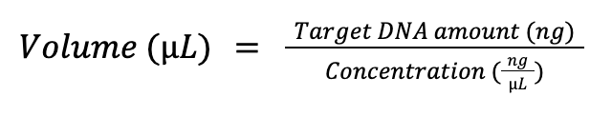
Pooling samples for even sequencing coverage
Batch | Sample name | Barcode | Volume to pool | Amount in pool
1 | Sample 1 | 1 ng/µL | ______ µL | ______ ng
1 | Sample 2 | 0.1 ng/µL | ______ µL | ______ ng
1 | Sample 3 | 0.5 ng/µL | ______ µL | ______ ng

Slide 25
Pooling samples for even sequencing coverage
Batch | Sample name | Barcode | Volume to pool | Amount in pool
1 | Sample 1 | 1 ng/µL | 5 µL | 5 ng
1 | Sample 2 | 0.1 ng/µL | 50 µL | 5 ng
1 | Sample 3 | 0.5 ng/µL | 10 µL | 5 ng

Slide 26
Pooling samples for even sequencing coverage
Batch | Sample name | Barcode | Volume to pool | Amount in pool
1 | Sample 1 | 1 ng/µL | 5 µL | 5 ng
1 | Sample 2 | 0.1 ng/µL | 50 µL | 5 ng
1 | Sample 3 | 0.5 ng/µL | 10 µL | 5 ng

Slide 27
Pooling samples for even sequencing coverage
Batch | Sample name | Barcode | Volume to pool | Amount in pool
1 | Sample 1 | 1 ng/µL | 5 µL | 5 ng
1 | Sample 2 | 0.1 ng/µL | 10 µL | 1 ng
1 | Sample 3 | 0.5 ng/µL | 10 µL | 5 ng
 |  | Total Vol. | 25 µL

Slide 28
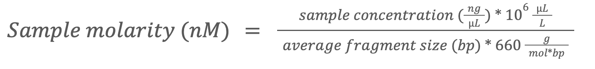
Calculating pool molarity
QuBit measurement
Tapestation or BioAnalyzer measurement
(SARS-CoV-2 tiled amplicon scheme fragment size typically ~450 bp)

Slide 29
Summary
Minimize contamination across samples through work space separation and other best practices
Keep materials like DNA, RNA, and enzymes at specified temperatures
Prepare reagents in quantities that account for inevitable volume loss
Pool equal amounts of samples to achieve even coverage during sequencing

